Slide 1
Shooting
How to make an object track a player

Slide 2
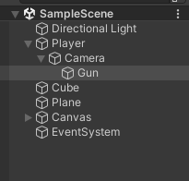
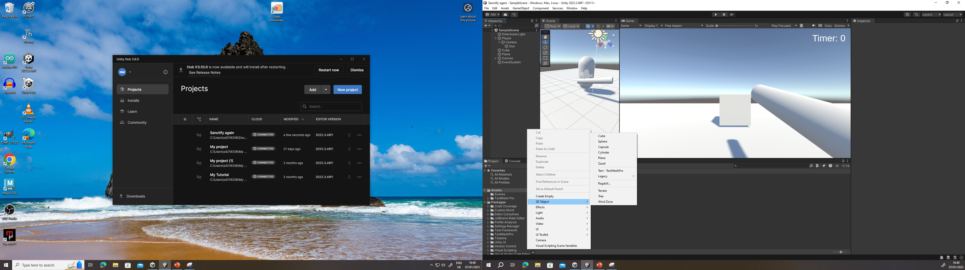
Code steps
You should add a a public GameObject, so if it’s a gun a cylinder would help
You should also add a projectile prefab, this is so that you have something such as a bullet to shoot
A public transform. So that the bullet will be instantiated
And public floats for the force and how fast the projectile will shoot

Slide 3
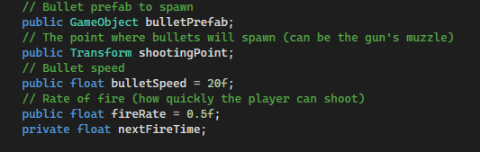
Code explanation
Prefab: it is a collection of game objects that are stored in the project panel. This is useful for reusing game objects and instantiate it.
Instantiate: this is a method to create a copy of an existing object. This can be used to place rotation or position
Transform: this is a component that stores information of what method you have set the object

Slide 4
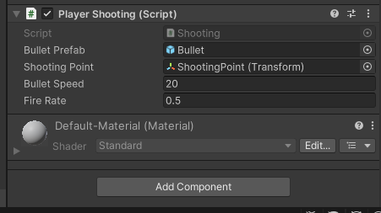
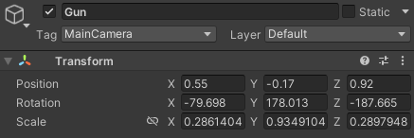
Adding the components in Unity
For the shooting codes to work, you will need to add things into unity
You can scale this 3d object in the inspector
You must create a 3d object and attach the script

Slide 5

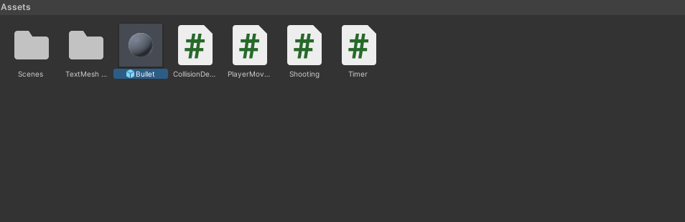
Adding the components in Unity .2
The main use of this object is to make it shoot out projectiles
Create a sphere in the 3D objects and scale it to fit the cylinder
You should make a bullet prefab, in order to do this you must attach the 3d object into the project window

Slide 6
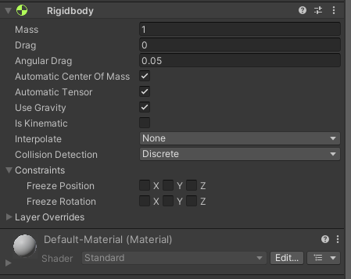
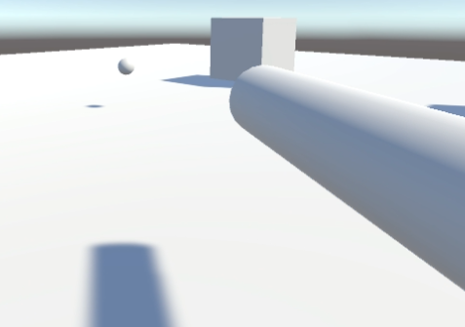
Make a RigidBody
Making a RigidBody will enable the GameObject to interact with the game itself. In this case, this will allow the gun to shoot out the bullets.

